Slide 1
ML Decoders for
Quantum Error Correction
Team 22
Ali Moallin · Carson Brice · Daniel Kowalski · Nate Herman
10/08/2026 · ECE 3906: Capstone Design 1
Notes:
Presenter: [Team Member].
Fill in the project title, team name (if any), all team member names, and the presentation date.

Slide 2
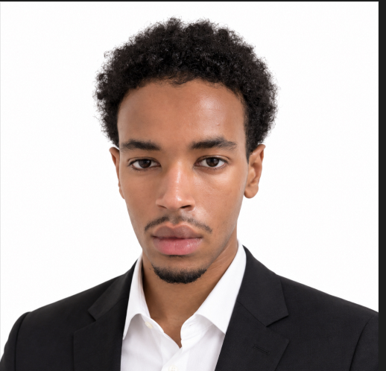
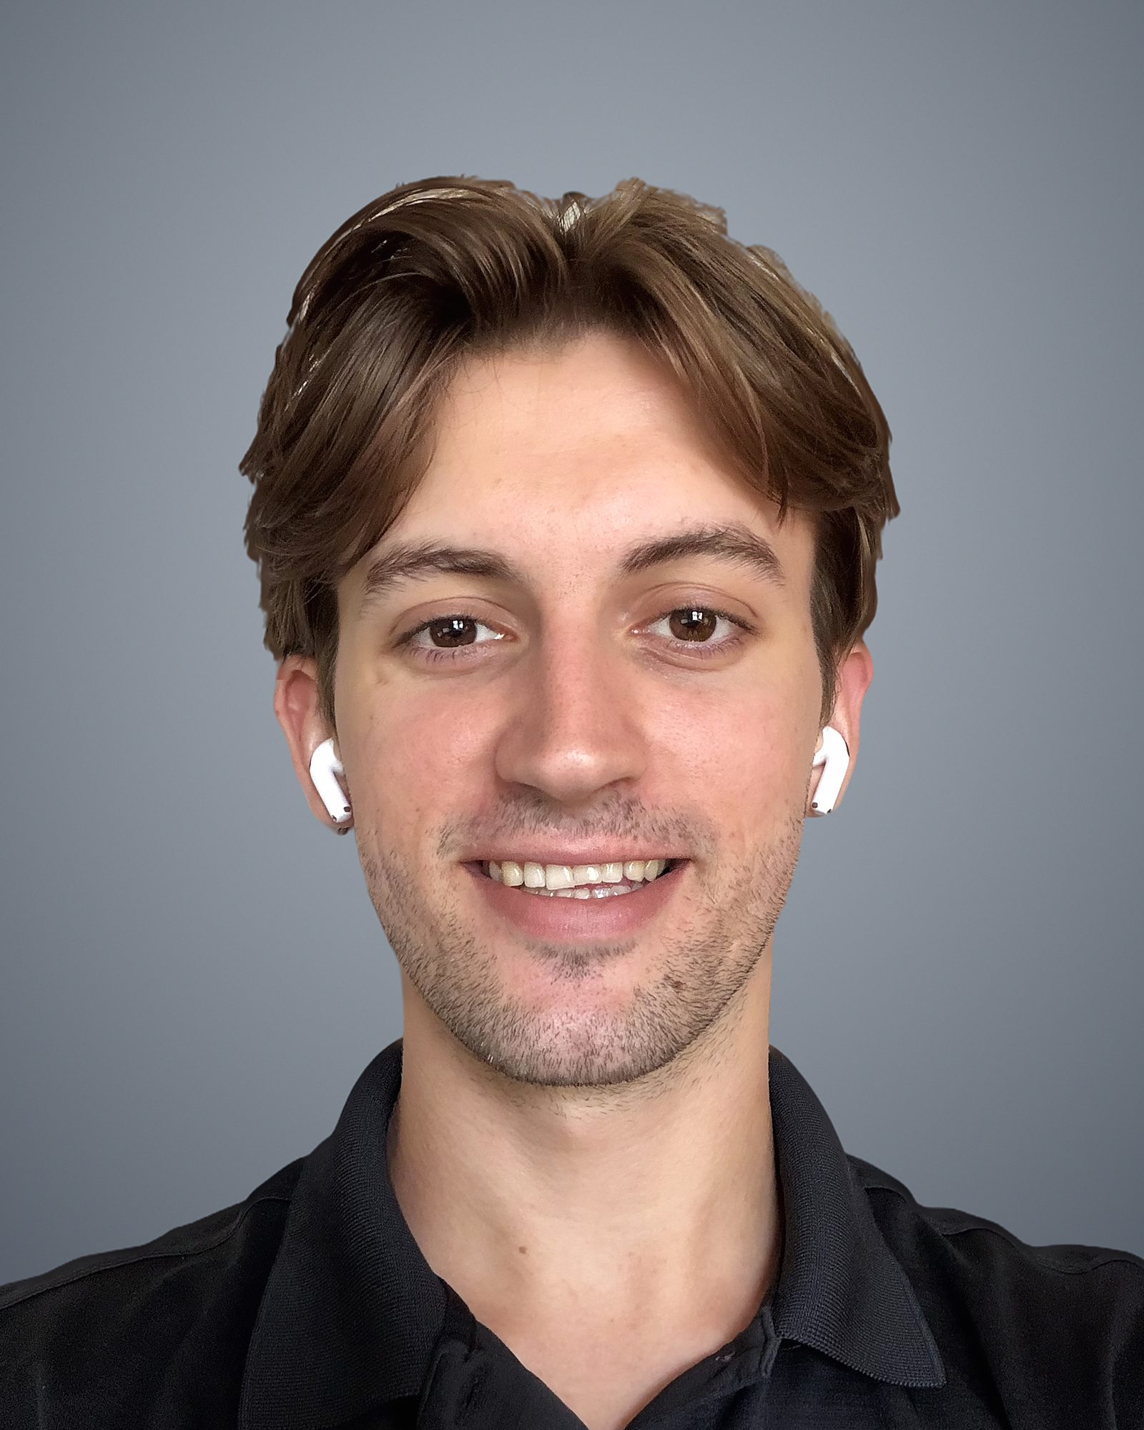
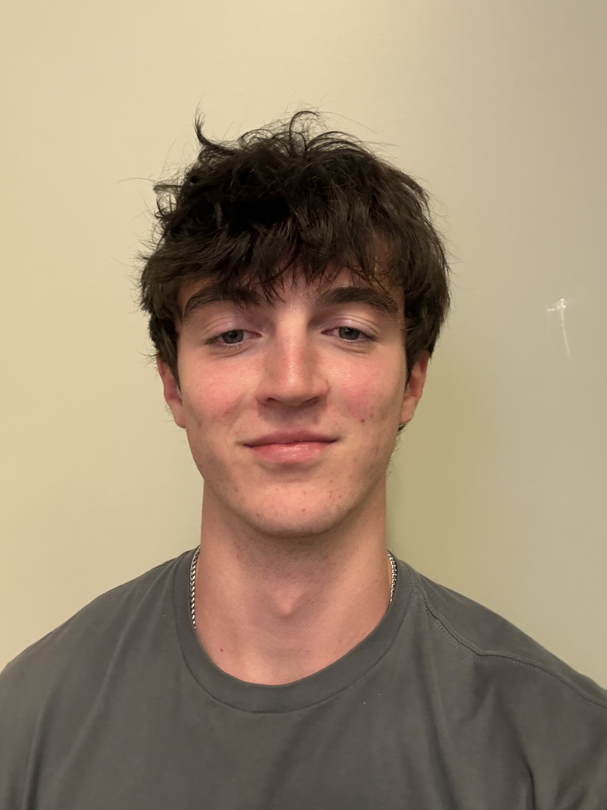
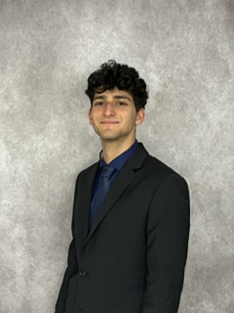
Meet Team 22
Ali Moallin
Carson Brice
Daniel Kowalski
Nate Herman
Data Pipeline Engineer
QEC & ML Theory Lead
Machine Learning Engineer
Data Scientist
Notes:
Each team member introduces himself or herself and their technical role on the team.
Replace each gray placeholder with a headshot (right-click > Change Picture keeps the size and position). Add or delete a column if the team has a different number of members.

Slide 3




Background: Error Decoding
Decoding is a primary bottleneck for fault-tolerant quantum computers [1]
BOTTLENECK [1]
0
1
0
0
1
0
Noisy qubits
Stabilizer checks
Syndrome
Decoder
1 logical qubit = many physical qubits [3]
Parity of small qubit groups
Bit string every round
Infers which errors occurred [3]
Fast: ~1 µs per round [6], [7]
Accurate: avoid logical errors [3]
Notes:
Presenter: [Team Member].
Quantum computers store information in quantum bits (qubits), which are easily disturbed by environmental noise, causing the loss of the information stored in the state of the qubit [2]. Quantum error correction (QEC) protects this information by spreading each logical qubit across multiple physical qubits [3].
The hardware repeatedly measures stabilizers, which are parity checks on small groups of physical qubits, and each round of measurements produces a string of bits called a syndrome.
A classical program called a decoder infers errors from syndromes, and each wrong inference causes a logical error that corrupts the stored information [3].
Real-time decoding requires processing each measurement round in about 1 microsecond on current superconducting hardware [6], [7]. This is why error decoding is a primary bottleneck in building fault-tolerant quantum computers [1].

Slide 4




Problem Definition
MWPM
Standard decoder [4], [5]
ML decoders
Learn from data [6]
vs
Hand-designed
Fewer logical errors [6]
Simplified noise model
Too slow for real time [6], [7]
Two ML decoders that outperform MWPM within size and latency limits
Notes:
Presenter: [Team Member].
The standard decoder, minimum-weight perfect matching (MWPM), is a hand-designed algorithm that relies on a simplified noise model [4], [5].
Machine learning (ML) decoders learn error patterns directly from data and have recently produced fewer logical errors than MWPM on experimental data [6]. However, the most accurate published ML decoder is too slow for real-time decoding, which requires processing each measurement round in about 1 microsecond on current superconducting hardware [6], [7].
Dr. Youngseok Kim, an assistant professor at The Ohio State University who researches quantum computing, tasked Team 22 with developing two ML decoders that can outperform MWPM while balancing size and latency constraints.

Slide 5





Problem Scope
1. Generate data
2. MWPM baseline
3. Two ML decoders
4. Compare
Labeled syndromes
from Stim [8]
Accuracy reference
Feed-forward / CNN
Recurrent / Transformer
Accuracy and size
vs. MWPM
Train: Stim simulations [8]
Test: real quantum hardware datasets
Out of scope (stretch goal): FPGA implementation at ~1 µs [6], [7]
Notes:
Presenter: [Team Member].
The project breaks down into four parts: generating a labeled syndrome dataset using the Stim Python library [8], implementing an MWPM model as an accuracy baseline, developing two ML decoder models, and an accuracy comparison and size evaluation between the models and MWPM.
The first ML decoder must be a feed-forward or convolutional neural network; the second must be a recurrent or transformer-based neural network.
Stim will generate simulated data to train the models, and publicly available datasets from physical quantum computers will be used to test/fine-tune them.
Outside the current scope: a stretch goal is implementing the models on a field programmable gate array (FPGA). That brings the ~1 microsecond inference time constraint [6], [7], and the inference code would need to be translated to a more performance-optimized language like C++.

Slide 6




Constraints & Assumptions
Constraints
Assumptions
No quantum computer
Public datasets are labeled and similarly formatted
BIGGEST
Fixed course timeline
No high-power GPUs
Stim’s simulated noise ≈ real hardware
Based on AlphaQubit [6]
Python only
Required model types
Notes:
Presenter: [Team Member].
Constraints: time, compute, Python, no access to a physical quantum computer, and the required model types.
- Time: there is a fixed time period for this course.
- Compute: lack of availability of high-power GPUs to train the models on.
- Python and the required model types limit the available routes to take to achieve success.
- No physical quantum computer: the biggest constraint, because it limits the training and testing of the models' capabilities.
Assumptions:
- Public datasets are labeled and output in a similar format; without this, the accuracy tests on public datasets will be detrimental.
- Simulated noise generated by Stim models physical quantum computers closely enough to be effective. This is based on the AlphaQubit research [6], but when training on a smaller model or dataset it may no longer hold true.

Slide 7





Stakeholders
Dr. Kim
Team 22
Future students
Dr. Z
QEC researchers
Project sponsor
Capstone team
Dr. Kim & Dr. Gupta
Course instructor
Academia & industry
Proof-of-concept ML decoders
Graduation and new skills
Reusable code and data
On-time, quality work
Reproducible benchmarks
Notes:
Presenter: [Team Member].
Dr. Kim (project sponsor; quantum researcher): wants proof of concept of ML decoders in a real-time environment that surpass current hand-developed algorithms. The research can open new routes for researching and building a fault-tolerant quantum computer, including future collaboration with Dr. Jay Gupta on implementing a hardware-optimized algorithm on an FPGA board.
Team 22 (capstone design team): graduation, new technical skills, and professional experience; must deliver a working, well-documented result within the course schedule to pass.
Future students of Dr. Kim and Dr. Gupta (successors of Team 22's research): want reusable code, data, and documentation; otherwise they must rebuild the data pipeline and ML models.
Dr. Z (capstone course instructor): on-schedule progress, professional conduct, and high-quality technical writing; accountable for the team's successful completion of the approved and assigned project.
QEC researchers (academic and industry developers): reproducible benchmarks against MWPM; reproducible results open new gateways for research.

Slide 8
Needs Assessment
RANK
NEED
STAKEHOLDERS
PRIORITY
1
Two ML decoders that beat MWPM
Dr. Kim, QEC researchers
Essential
2
Stim data-generating pipeline
Dr. Kim
Essential
3
Trustworthy MWPM baseline
Dr. Kim, QEC researchers
Essential
4
All capstone deliverables
Team 22, Dr. Z
Essential
5
Python code and documentation
Dr. Kim, future students, Dr. Z
Important
6
Strong understanding of MWPM
Team 22
Important
Notes:
Presenter: [Team Member].
Each need is ranked on two factors: how directly the need answers Dr. Kim's proposal and whether other needs are dependent on it.
1. Two ML decoders that surpass MWPM in accuracy (Dr. Kim, QEC researchers): answers the central question of the capstone proposal. The margin by which they must beat MWPM is currently undecided and will be based on MWPM's accuracy on the simulated datasets.
2. Data-generating pipeline using Stim (Dr. Kim): the data the models are trained on, so a bad dataset means a bad model.
3. Trustworthy MWPM baseline (Dr. Kim, QEC researchers): comparison against it provides proof of the ML decoders' efficacy.
4. Completion of all capstone deliverables (Team 22, Dr. Z): needed for graduation under course requirements.
5. Python code and documentation (Dr. Kim, future students, Dr. Z): facilitates easy hand-off of the research.
6. Strong understanding of MWPM (Team 22): MWPM can be implemented without it, but a stronger understanding helps find areas where MWPM fails.
For Dr. Kim, success at this stage means a validated MWPM baseline, a data-generating pipeline that accurately models physical quantum computers, and two ML decoders that outperform MWPM on simulated and experimental datasets.

Slide 9
Requirements Definition
Needs | Requirement | Units | Range | Ideal
Two ML models outperform MWPM | Two ML models outperform MWPM on the same test dataset that is statistically significant with a 95% confidence level. | % | >0% | TBD
Trustworthy MWPM | MWPM baseline produces similar logical error rates as published research | % | +/- 2% | +/- 1%
Simulated data matches physical computers | All datasets need to have realistic code distances and physical error rates | Code distance; error rate (%) | TBD | TBD
Written in Python | All code must be written and documented through Python | Programming Language | Python 3 | Python 3
Strong understanding of MWPM | A documented handwritten analysis of MWPM with explanations of what it succeeds in and what it fails at | - | TBD | TBD
Completion of all Capstone Deliverables | Must complete all capstone deliverables on time | Seconds and days | <0s late | > 1 day early
Notes:
Presenter: [Team Member].
Logical error rate is the fraction of test runs in which a decoder's correction leaves a logical error. Team 22 and Dr. Kim will set the values marked to be determined (TBD) after the MWPM baseline results are available.

Slide 10
References
[1] F. Battistel et al., “Real-time decoding for fault-tolerant quantum computing: Progress, challenges and outlook,” Nano Futures, vol. 7, no. 3, Art. no. 032003, Aug. 2023, doi: 10.1088/2399-1984/aceba6.
[2] J. Preskill, “Quantum computing in the NISQ era and beyond,” Quantum, vol. 2, p. 79, Aug. 2018, doi: 10.22331/q-2018-08-06-79.
[3] A. G. Fowler, M. Mariantoni, J. M. Martinis, and A. N. Cleland, “Surface codes: Towards practical large-scale quantum computation,” Phys. Rev. A, vol. 86, no. 3, Art. no. 032324, Sep. 2012, doi: 10.1103/PhysRevA.86.032324.
[4] O. Higgott, “PyMatching: A Python package for decoding quantum codes with minimum-weight perfect matching,” ACM Trans. Quantum Comput., vol. 3, no. 3, pp. 1–16, 2022, doi: 10.1145/3505637.
[5] E. H. Chen et al., “Calibrated decoders for experimental quantum error correction,” Phys. Rev. Lett., vol. 128, no. 11, Art. no. 110504, Mar. 2022, doi: 10.1103/PhysRevLett.128.110504.
[6] J. Bausch et al., “Learning high-accuracy error decoding for quantum processors,” Nature, vol. 635, no. 8040, pp. 834–840, Nov. 2024, doi: 10.1038/s41586-024-08148-8.
[7] Google Quantum AI and Collaborators, “Quantum error correction below the surface code threshold,” Nature, vol. 638, no. 8052, pp. 920–926, Feb. 2025, doi: 10.1038/s41586-024-08449-y.
[8] C. Gidney, “Stim: A fast stabilizer circuit simulator,” Quantum, vol. 5, p. 497, Jul. 2021, doi: 10.22331/q-2021-07-06-497.
[9] IBM Quantum, “How IBM will build the world’s first large-scale, fault-tolerant quantum computer,” IBM Quantum Blog, Jun. 10, 2025. Accessed: Oct. 1, 2026. [Online]. Available: https://www.ibm.com/quantum/blog/large-scale-ftqc
Notes:
Not presented aloud; included so the citations on the slides can be checked.

